Slide 1
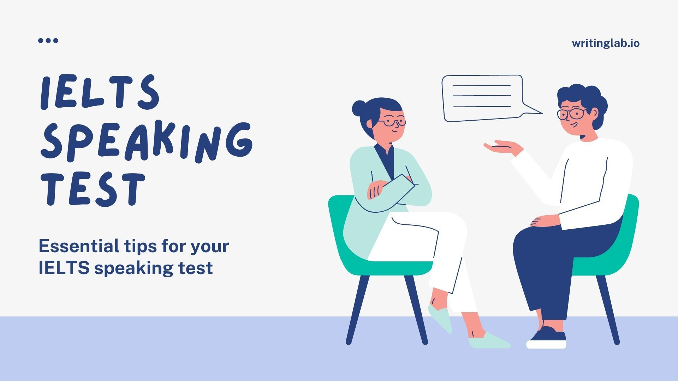


Slide 2
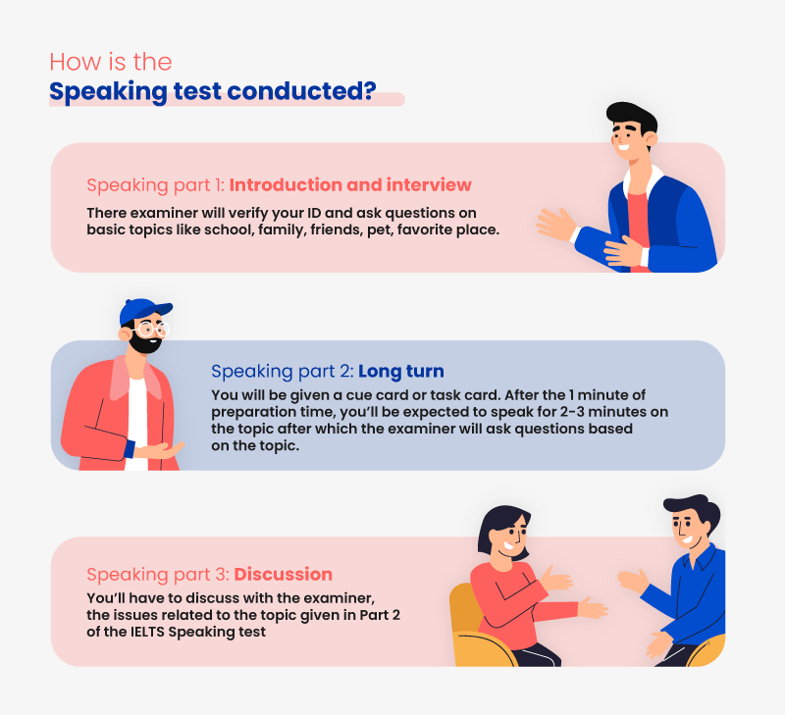

Slide 3
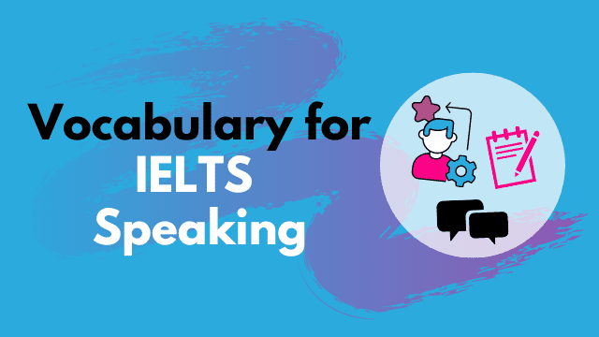
Key facts about IELTS Speaking Part 1
1) Time – 4-5 minutes.
2) You’ll be asked questions about you and your life.
Common topics:
Your home
Your family
Your work or study
Your hometown
Your likes or dislikes
Your interests
3) You will only be assessed on your English language skills, not on the content of what you actually say.

Slide 4

Mistakes to Avoid
Ensure you don't make these common mistakes:
Don’t give very short answers.
Don’t give very long answers.
Don’t memorise answers.
Don’t overthink answers.
Don’t freeze if you get ‘unusual’ questions.

Slide 5
Developing your Answers
Giving the correct length answers is very important. Which of these answers to this question is the best?
Question: Do you like music?
John: Yes, I do.
Max: Most definitely. I go to lots of live concerts as I have got a friend who is in a band. At home, I like to relax by listening to classical music.

Slide 6
Paraphrasing
Question: Have you visited any foreign countries?
Answer 1: Yes, I have visited two foreign countries, the UK and Egypt. My favourite foreign country was the UK because it is very much different than my own country. Another country I want to visit is France.
Answer 2: Yes, I have been abroad a couple of times, first to the UK, then to Egypt. I particularly enjoyed the UK because it is so different than my own country. I would also love to travel to France.
Answer 2 is best.
Again, both versions answer the question but answer 1 repeats the verb ‘to visit’, and the words ‘foreign’ and ‘countries’, all of which are in the question, several times.
In answer 2, the question has been paraphrased with the synonym ‘abroad’, and ‘to travel to’ has been used instead of ‘visit’.

Slide 7
Stay Relevant
Question: How long have you been learning English?
John: I began studying English at school when I was just six years old and I have been working on my language skills ever since. I am 27 now so I have been an English student for 21 years.
Max: I have wanted to learn English since I was very young. Luckily I had a good teacher at school who made the lessons really interesting. I enjoyed English so much that I decided to keep learning when I left.
John gives the best answer. He answers the question and shows good language skills and paraphrases the question well.
Max also has a good command of the English language but he doesn’t actually answer the question. This will lose him marks. Don’t make this mistake.

Slide 8
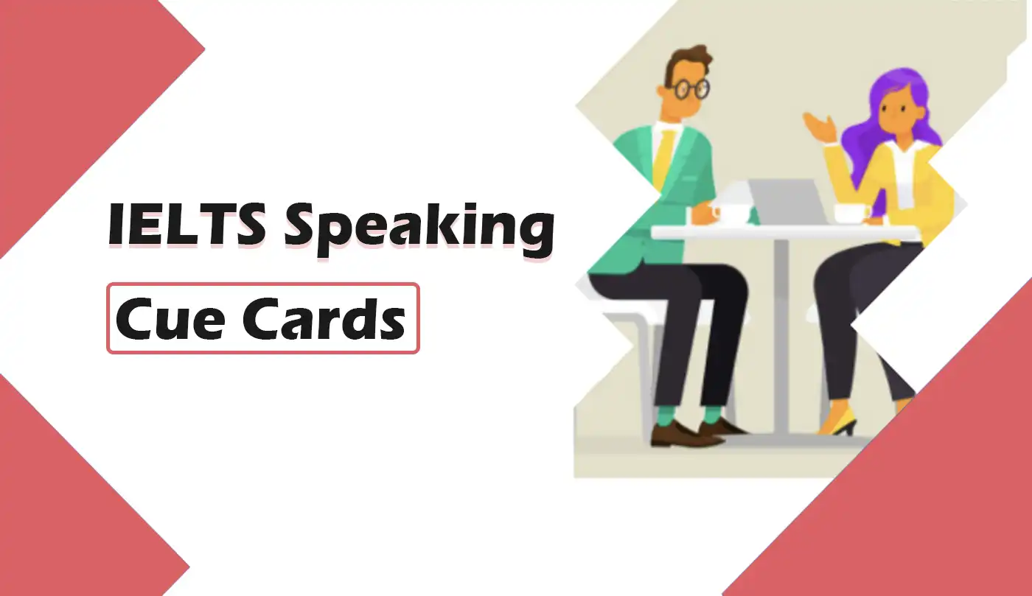
Key facts about IELTS Speaking Part 2
Total time: 3-4 minutes
- The examiner will give you a cue card with a topic written on it.
- It will also have 3-5 bullet points telling you what to include in your talk.
- You will be given 1 minute for preparation during which you are allowed to make notes.
- You will be asked to speak on this topic for up to 2 minutes.

Slide 9
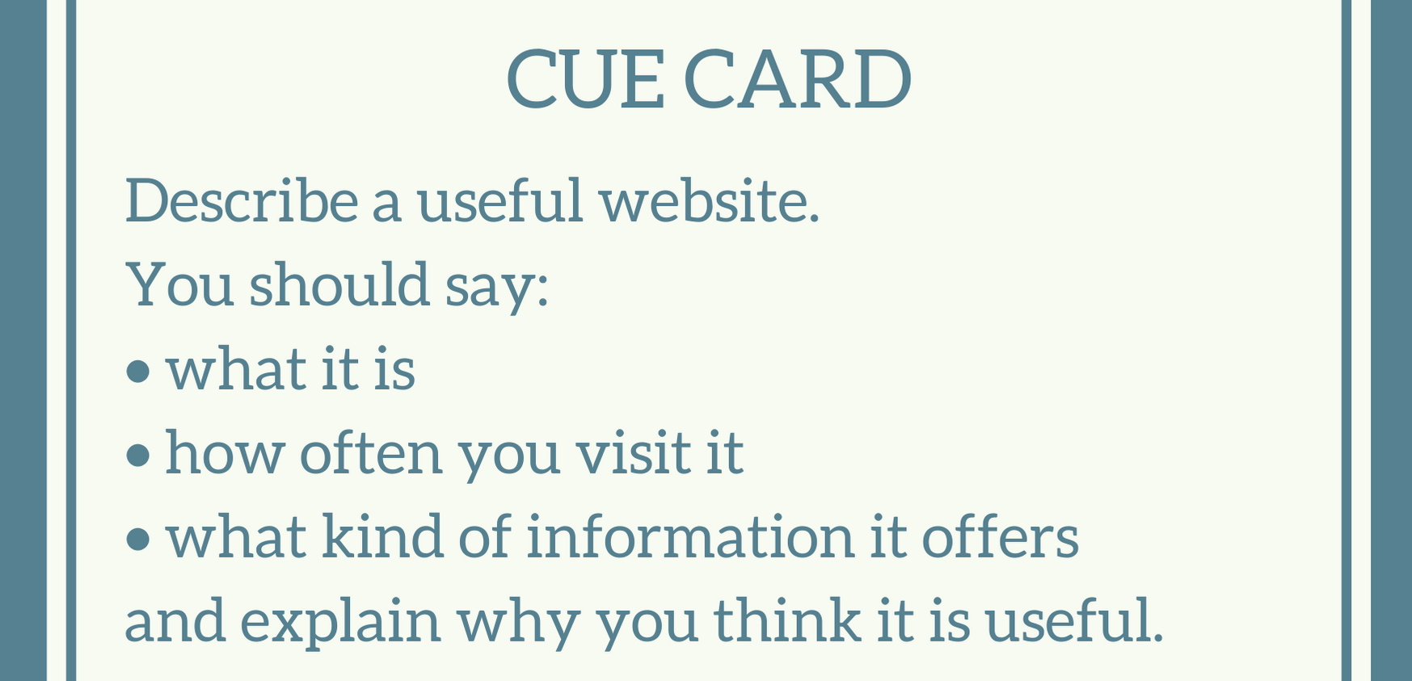
Speaking Part 2

Slide 10
IELTS Speaking Part 3
1) It is a two-way discussion with the examiner lasting for 4-5 minutes.
2) You will be asked more questions about your Part 2 topic.
3) It gives you the opportunity to show a greater range of speaking skills.
4) The examiner’s questions will encourage you to express your thoughts, feelings and opinions.
5) You will only be assessed on your English language skills, not on the content of what you actually say.

Slide 11
Common Mistakes in Speaking Part 3
Their answers are too short.
They get stressed over difficult questions.
They don’t listen carefully to the question.
They don’t fully understand the question.

Slide 12
Types of Question for Speaking Part 3
1) Opinion
2) Hypothetical
3) Compare and Contrast
4) Change
5) Future
6) Benefits

Slide 13
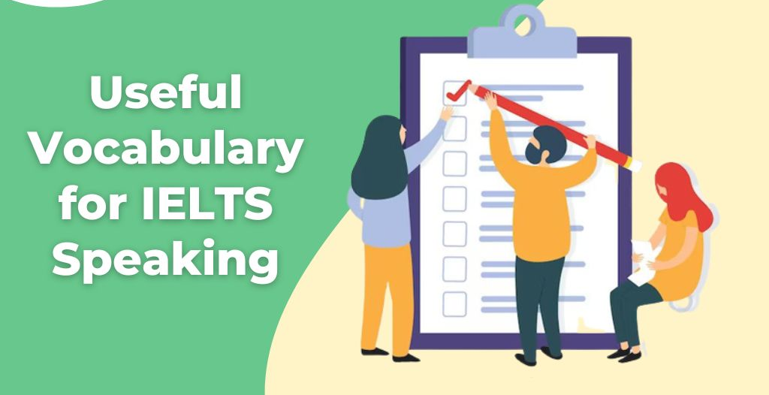

Slide 14
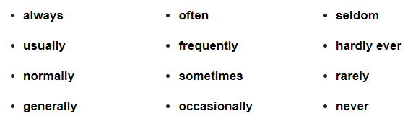
Frequency of using Common Words
Extended answer: I normally see my friends most days of the week, especially my best friend who I generally catch up with after work. At the weekends, a group of us often go to the park to play football or chill out.

Slide 15
Frequency of using Common Words
Connectives that express contrast are equally useful for extending answers.
Extended answer: I try to meet up with friends several times a week but rarely on a Sunday because that is when I visit my family. However, every few months I cook a barbeque for Sunday lunch and invite both my friends and family around.

Slide 16
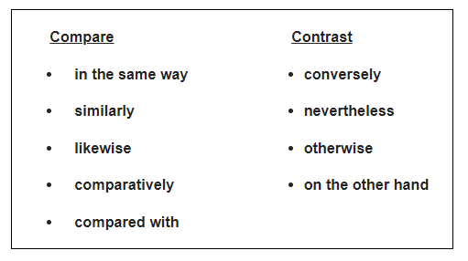
Frequency of using Common Words

Slide 17
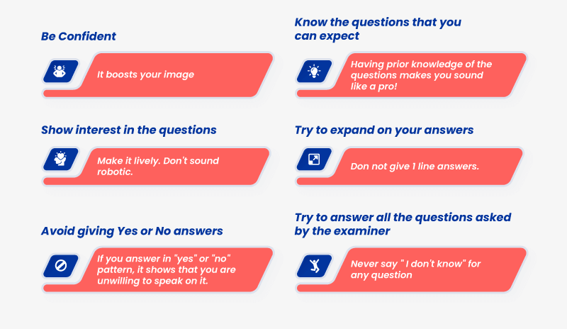
Tips

